Slide 1
B- Control Design and Implementation
  Selected controls should be tested in an environment distinct from the production environment before implementation. this test environment should mimic the production environment.
  before, establishing such test environments tended to be extremely costly. Today, with virtualization and container technology, it may be relatively trivial to establish a testing environment, even as a temporary arrangement to evaluate specific capabilities.
  Successful testing of new or enhanced controls is a necessary precondition before committing to a changeover(Go-live) .
  The changeover process should be coordinated through formal change management.
  Implementation and testing should not be limited to technical controls. Administrative and physical controls require comparable levels of coordination, and evaluation before being fully implemented and relied upon to deliver intended outcomes.

Slide 2
Changeover (Go-live) Techniques
After final tests have been conducted and change management has been coordinated, implementation begins as scheduled.
There are Four common changeover methods used to transition from one system, technology, application or version to another:
  Parallel
  Phased
  Pilot Running
  Direct/Abrupt (Sudden)
Additionally, every changeover should account for the possibility of a fallback (rollback) scenario.

Slide 3
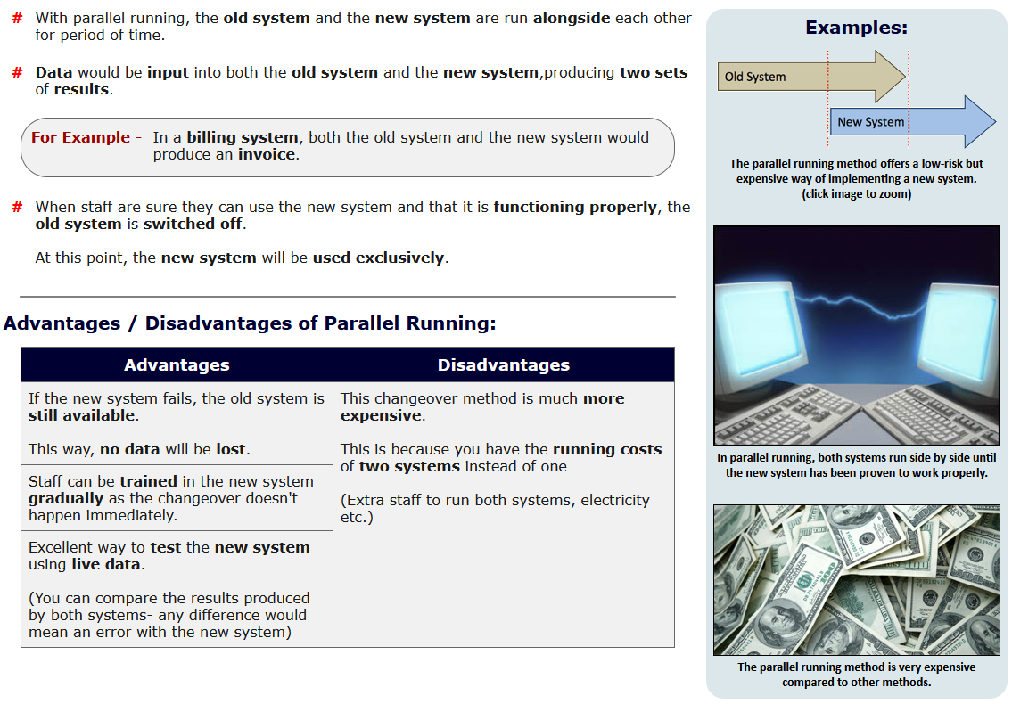
Parallel Changeover

Slide 4
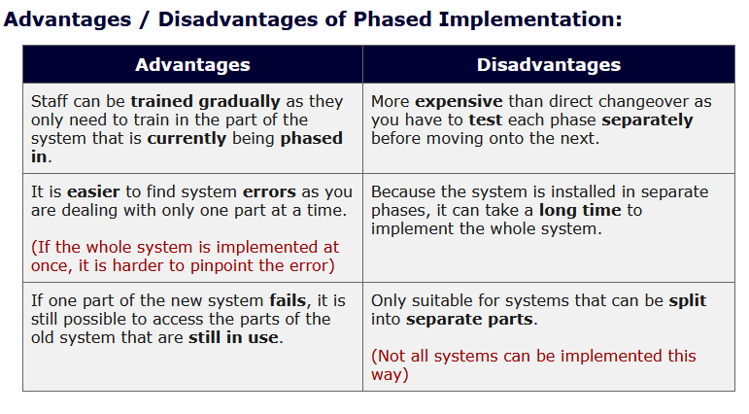
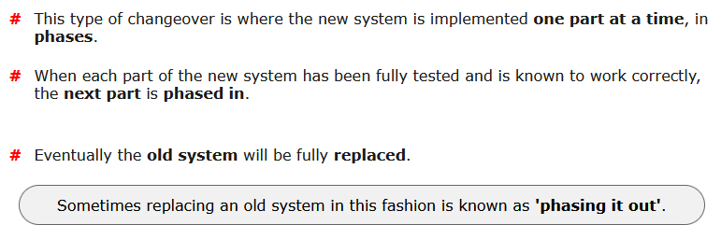
Phased Changeover
  In this approach the older system is broken into deliverable modules. Initially, the first module of the older system is phased out using the first module of the newer system.
  Then, the second module of the older system is phased out, using the second module of the newer system, and so forth until reaching the last module.
  Thus, the changeover from the older system to the newer system takes place in a preplanned, phased manner.
Phased changeover

Slide 5
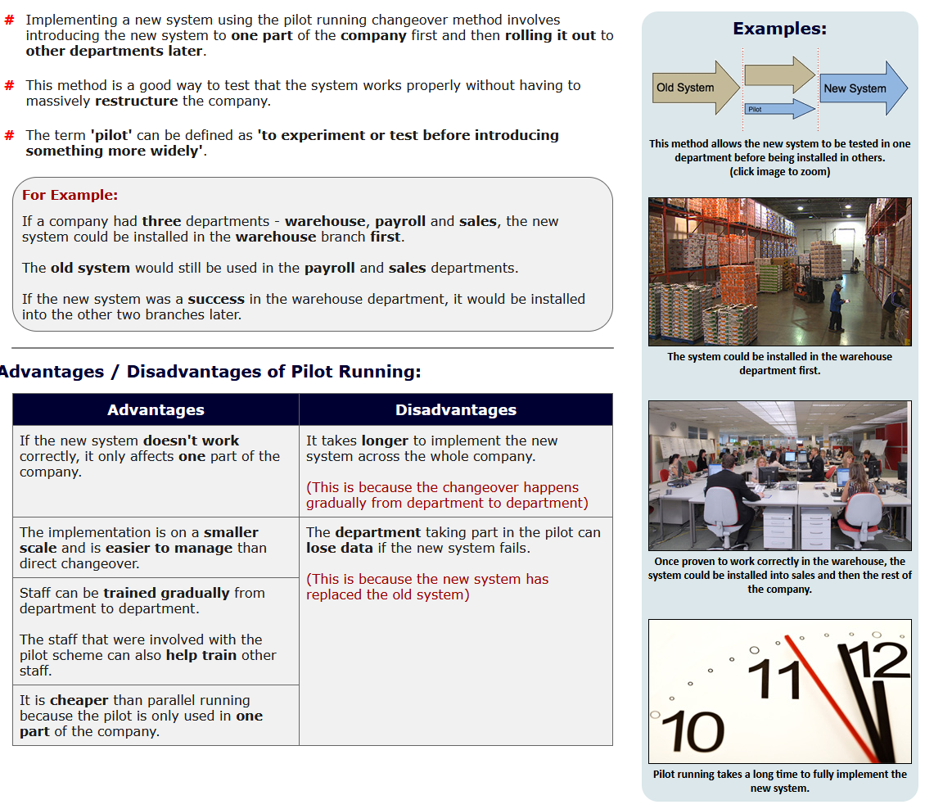
Pilot Running

Slide 6
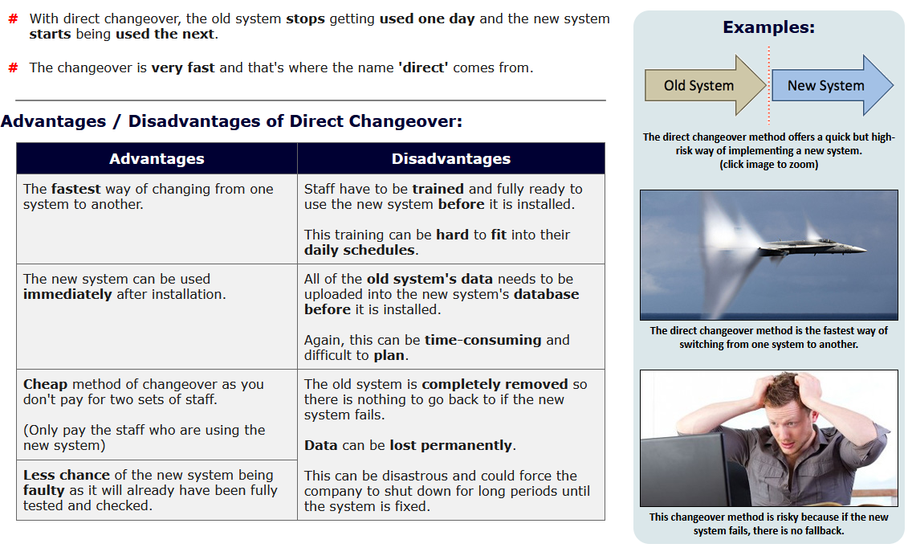
Direct/Abrupt (sudden) Changeover

Slide 7
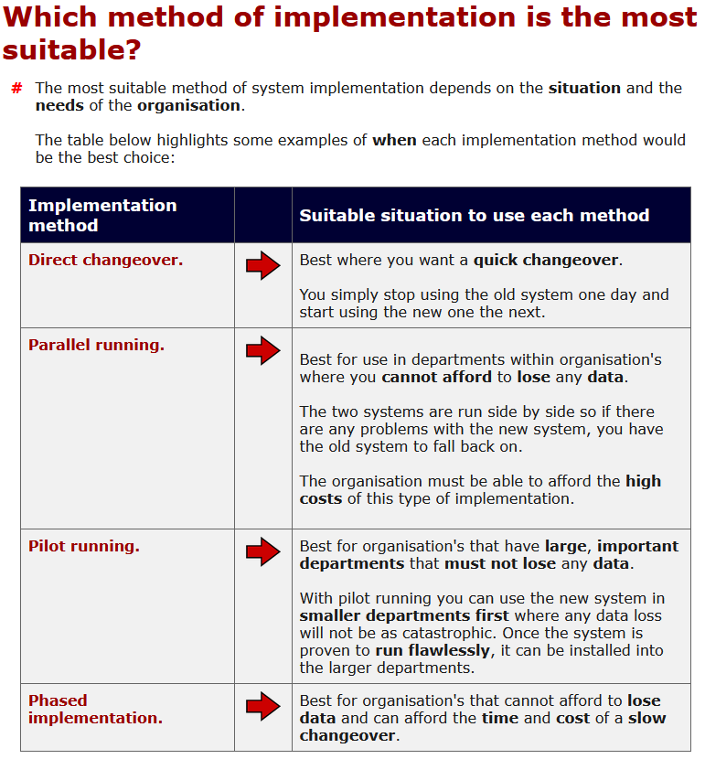
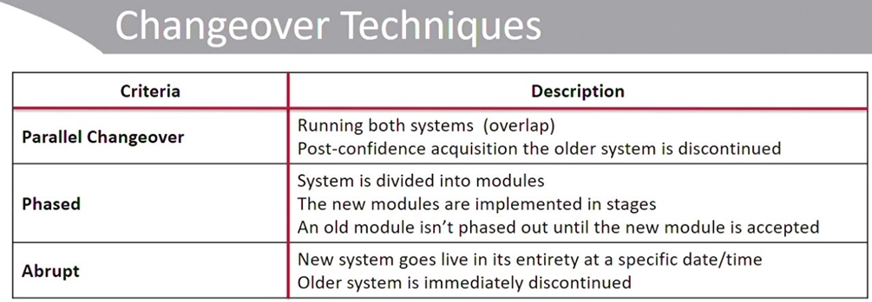

Slide 8
Fallback (Rollback)
  In any change scenario, whether it involves implementing a new system or making changes to an existing system, there is always a possibility that the change will not work as anticipated.
  Regardless of the cause of failure, the project team should have a fallback plan so that it is possible to return to the pre-change status and resume normal processing.
  The procedures for this reversion should be developed and approved as carefully as the change plan and subjected to rigorous testing before the changeover is attempted.

Slide 9
Post-implementation Review
Whether an implementation project succeeds or fails, a timely post-implementation review offers the best opportunity to capture lessons learn so that they can be applied to future projects.
Some questions to ask during the review include the following:
  What went well during the project, and what could have been done better?
  Did the project bring the risk within acceptable risk levels?
  Were all user requirements and business objectives met?
  If any inadequacies or deficiencies have been identified, how might these be addressed now?
  Were specified methodologies, standards and techniques followed? If not, why not?
  How does the final cost compare to estimates?
  Were the project targets accomplished in terms and resources or were additional ones needed?
It is considered a good practice to hold a post-implementation review as soon after completing an implementation project.
However, not all lessons associated with a given project may be immediately evident. A second, joint review by the implementation team and key stakeholders is often worthwhile after the project has been completed and changes have been in production for a sufficient time period to assess their effectiveness and value to the enterprise.

Slide 10
Control Documentation
The risk practitioner plays a key role in ensuring that controls are properly set up, operated, maintained and evaluated, with results reported to management on a regular basis.
Control management procedures include:
  Proper installation
  Creation of policies and procedures to support operations
  Implementation of change management procedures to ensure correct configuration
  Training of staff to monitor, manage and review controls
  Assignment of responsibility for monitoring and investigation
  Creation of a schedule for review and reporting
  Measurement of initial key performance indicators (KPIs)
As risk responses are implemented, the risk practitioner should ensure that each mitigation project has been implemented according to the intent and design of the project architects and that any changes did not erode or diminish effectiveness.
Each control should have its own documentation that includes justification for its implementation, accountable and responsible owners, and review and reporting schedules.

Slide 11
Control Testing and Effectiveness Evaluation
  Controls exist to mitigate risk. When improperly implemented, the opposite may occur; not only may a control fail to meet business requirements, poor implementation or functional inadequacy may result in a security breach.
  Control testing is an opportunity to uncover flaws early enough to prevent that failure and do so cost-effectively.
  A comprehensive testing program includes testing at as many levels
  This includes testing at unit/component, integration/system and end-user levels.
  Progressive testing begins with expectations and looks for flaws, while regressive testing works backward from known problems to identify causes.
  Both forms of testing are commonly used throughout the testing process. The risk practitioner may find regression testing to be useful in determining whether incidents have root causes in policy or standards.

Slide 12
Good Practices for Testing
Effective testing typically considers specific considerations for Environmental Separation , version control and code Locking
  Environmental Separation
      As mentioned previously, development or testing environments should be separated from production areas to prevent the potential for cross-population of data or application code outside the approval process.
      Depending on the enterprise, this separation may be done at the network level, may include physically separate workspaces, or may require entirely distinct teams of developers to be working on test and production systems.
      The risk practitioner should understand the separation model used by the organization and the rationale for managing separation in that fashion to ensure that it is consistently applied in practice.
      Wherever physical separation, logical separation or both are difficult, the enterprise should implement compensating controls comparable with the risk level.

Slide 13
Version Control
  There is always risk that a change to a system will overwrite or bypass functionality previously implemented or changed in a system.
  Version control refers to the assignment of specific version numbers or tracking mechanisms for each revision of a system, making it possible to distinguish between versions.
  Version control tracks the current iteration of something in development, checks for previous changes when a new change is implemented and can be used to ensure that the correct source version is staged for a move to production use.
  The risk practitioner should take care to ensure that reports from content reviews (including code testing) and other testing apply to the correct versions of components and systems
Code Locking
  Part of the process of moving a new or modified system or application into production is to lock down the source code in order to ensure that it cannot be modified or intentionally tampered with after it has been approved for final testing.
  Some organizations call this final version gold code or locked code.
  In high-sensitivity environments, integrity-checking tools such as digital checksums may be used to validate that no changes have been made since approval.

Slide 14
TESTING CLASSIFICATIONS
  The following tests relate to the approaches that can be performed based on the size and complexity of the modified system:
    Unit testing—The testing of an individual program or module. These tests ensure that the internal operation of the program performs according to specification.
    Interface or integration testing—
      A hardware or software test that evaluates the connection of two or more components that pass information from one area to another.
      The term “integration testing” is also used to refer to tests that verify and validate the functioning of the application under test with other systems, in which a set of data is transferred from one system to another.
    System testing—
      A series of tests designed to ensure that modified programs, objects, database schema, etc., which collectively constitute a new or modified system, function properly.
      These test procedures are often performed in a nonproduction test/development environment by software developers designated as a test team.

Slide 15
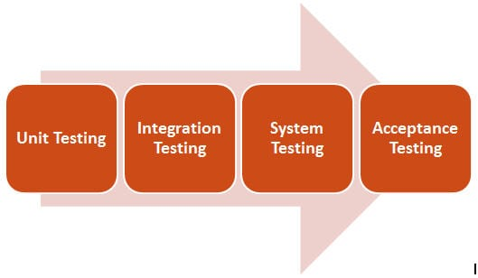
It is performed when Integration Testing is completed.
It is mainly a Black-box type testing. This testing evaluates the working of the system from a user point of view, with the help of a specification document. It does not require any internal knowledge of systems like the design or structure of the code.
It contains functional and non-functional areas of application/product.
  Focus criteria:
  It mainly focuses on the following:
    External interfaces
    Security
    Recovery
    Performance
    Operator and user’s smooth interaction with the system
    Install ability
    Documentation
    Usability
    Load/Stress

Slide 16
      The following specific analyses may be carried out during system testing:
        Recovery testing—Checking the system’s ability to recover after a software or hardware failure
        Security testing—Making sure the modified/new system includes provisions for appropriate access controls and does not introduce any security holes that might compromise other systems
        Load testing—Testing an application with large quantities of data to evaluate its performance during peak hours
        Volume testing—Studying the impact on the application by testing with an incremental volume of records to determine the maximum volume of records (data) the application can process
        Stress testing—Studying the impact on the application by testing with an incremental number of concurrent users/services on the application to determine the maximum number of concurrent users/services the application can process
        Performance testing—Comparing the system’s performance to other equivalent systems using well-defined benchmarks

Slide 17
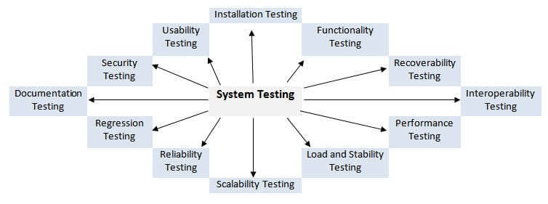
  Difference between System Testing and System Integration Testing:
    The main difference is:
        System Testing looks after a single system’s integrity with relevant environment
        System Integration Testing looks after multiple systems’ integrity with each other, being in the same environment.
        Thus, the system test is the beginning of real testing where you test a product as a whole and not a module/feature.

Slide 18
Final acceptance testing—
  Final Acceptance testing occurs during the implementation phase.
  Final acceptance testing has two major parts:
    quality assurance testing (QAT), focusing on technical aspects of the application
    UAT, focusing on functional aspects of the application.
  QAT and UAT have different objectives and, therefore, should not be combined.
  QAT
    It verifies that the application works as documented by testing the logical design and the technology itself.
    It also ensures that the application meets the documented technical specifications and deliverables.
    QAT is performed primarily by the IT department. The participation of the end user is minimal and on request.
    QAT does not focus on functionality testing.
  UAT
    supports the process of ensuring that the system is production-ready and satisfies all documented requirements.
    Ideally, UAT should be performed in a secure testing or staging environment.

Slide 19
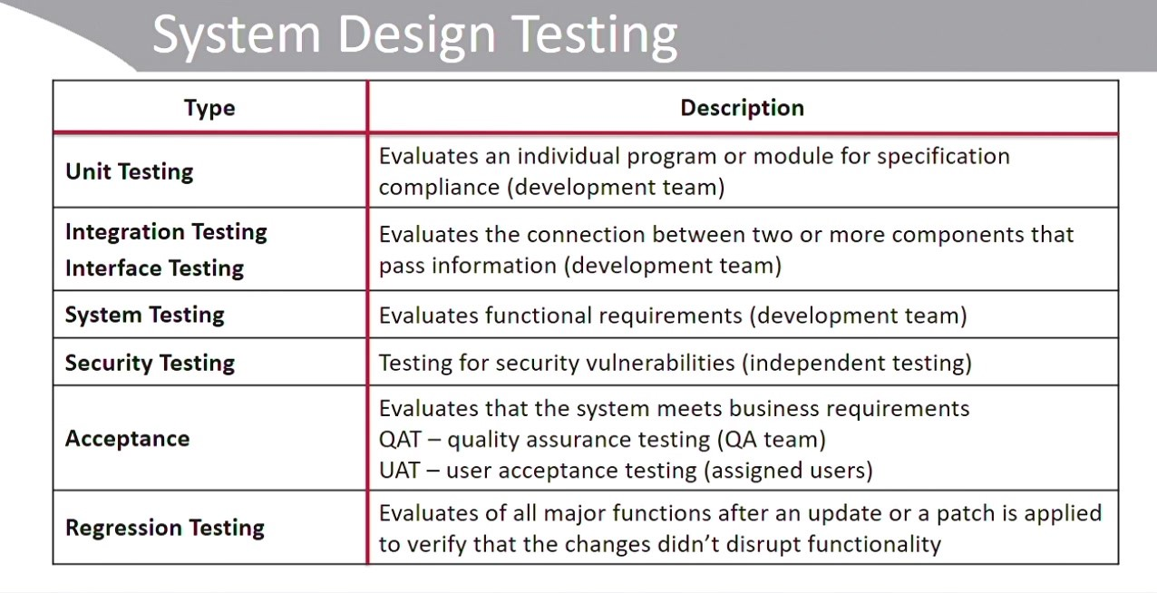

Slide 20
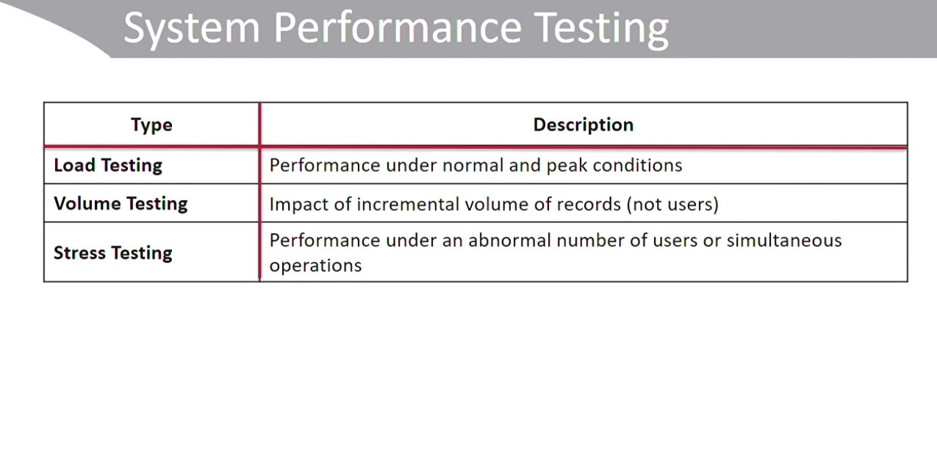

Slide 21
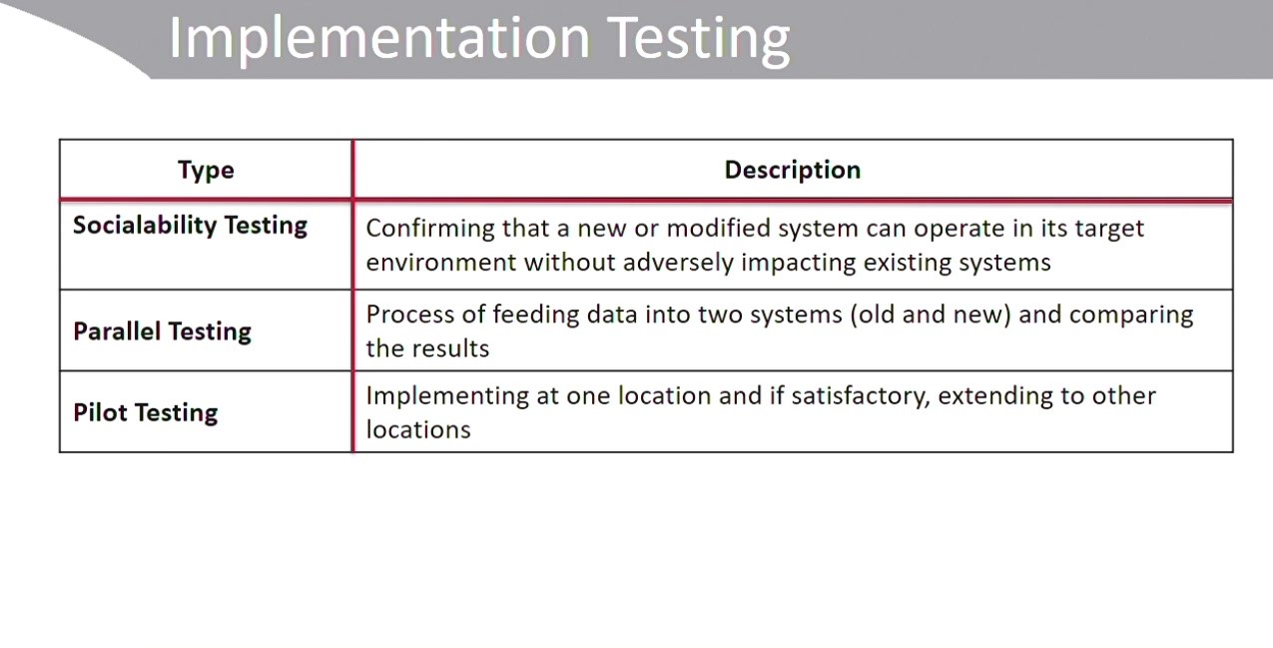

Slide 22
Effectiveness
The effectiveness of a control is determined by how well it fulfills its intended security function and protects assets. If a control is ineffective, it is not performing the intended security function for which it was designed or implemented, or it’s not performing it to the degree it needs to, leaving an asset vulnerable to threats and allowing an unacceptable level of risk to the asset or organization.
In these cases, control gaps must be closed (or reduced) by adding additional controls, or replacing the control.
Control effectiveness may not necessarily be the fault of the system administrators or security professionals.
Sometimes ineffective controls can be traced back to poorly defined requirements from the SDLC or ISSE process.
Measuring control effectiveness is closely related to the concepts of key risk indicators (KRIs) and key performance indicators (KPIs), as well as security metrics.

Slide 23
Efficiency
Efficiency relates more to how well the control does in relation to other factors, such as cost, maintainability, interoperability, and so on.
Even if a control is effective at what it’s supposed to be doing, is it costing too much to maintain it? Does it use up too many resources?
In looking at efficiency, the organization must consider controls that are not only effective but reasonable to operate and maintain in terms of the value they add and the level of protection they afford consistent with the asset’s value.
Process efficiency should also be a consideration in control selection and use.
A particular backup system, while effective, may require additional work processes or equipment to ensure its effectiveness or may add components and complexity to the infrastructure.

Slide 24
Economy of Use
Economy of use refers to the smart design and employment of controls such that they can be used to protect multiple assets at once or provide multiple security functions.
Controls that are used to protect only one single asset, or are single function, tend to be not as useful because additional controls that provide other functions and protect other assets are required.
Likewise, controls that are highly specialized in terms of function or level of protection tend to be more expensive, require more training, and may require more personnel or hours to manage and maintain
To achieve economy of use, you should examine different aspects of the architecture, data sensitivity and protection requirements, and common protection requirements of assets.

Slide 25
Meets Defined Requirements
In any event, if the control is not meeting the asset’s protection requirements, either the control (or its implementation) or the requirements are at fault.
This is why it’s so vitally important for the organization to implement a solid SDLC and ISSE process, as well as to put careful consideration into the selection of controls, including their design and implementation.

Slide 26
Control Redundancy
Defense in depth principle actually encourages multiple, redundant controls, implemented at different levels of the infrastructure or at various points in the system or data processing cycle to provide sustained protection.
Control redundancy should be looked at to provide effective protection for an asset but still should be balanced with good design principles.
Redundant controls that cover many systems at once and several different types of data, or even serve different security functions simultaneously, should be looked at and implemented.

Slide 27
Selecting the Control Baseline
A baseline is a selected set of controls that apply to a particular security categorization
NIST defines three security baselines: High, Moderate, and Low. Each baseline, starting with Low, offers a certain level of protection for the data type in question. With progressively higher baselines, more controls are added, or the depth of those controls is increased, providing more protection.
organizations aren’t strictly tied to these security baselines; they are tailorable by the organization, based upon its unique security requirements

Slide 28
Implementing Controls
Implementation of controls simply means that once the controls have been approved and resourced by management, they are put in place.
    Often this means installing technical solutions (software, equipment, or new configurations)
    it also may mean creating and implementing policies and other administrative controls.
    It also may mean installing physical controls or implementing new or modified processes.

Slide 29
Evaluating Existing Control Effectiveness
There are several ways to determine control effectiveness; performance monitoring and testing are the most common.
Performance monitoring usually takes the form of examining metrics or data produced while the control is performing its normal function.
Testing is definitely a way to measure the effectiveness of security controls, such as vulnerability assessments and penetration testing.

Slide 30
Adjusting Controls Based on Mitigation Requirements and Control Gaps
Control gaps must be closed, or at least reduced to an acceptable level.
The risk practitioner, in conjunction with management, will have to devise a strategy, based on risk appetite, tolerance, protection requirements, and resources, to close control gaps.
Adjusting controls to make up for gaps may require several different actions.
    You’ll need to decide whether to simply reconfigure the control,
    Supplement (add an extension) the control, or add new controls entirely.
    You may have to replace the existing control with a totally new one. In any case, whichever action you take, after you’ve adjusted the control, you should retest it to ensure that it meets the protection requirements for the asset in question.

Slide 31
Supplementing Existing Controls
Supplementing existing controls is an action you can take when the control already in place is doing somewhat of a good job, but maybe it’s not quite enough.
Perhaps there are new threats that weren’t originally considered when the control was implemented, or perhaps the control has become somewhat obsolete.
In any case, it may be more cost-effective simply to supplement an existing control by adding controls at other points in the infrastructure to offset the control gap or to temporarily add controls until a more permanent solution can be found.
In any case, you’ll need to test and make sure that any changes you make to a control meet the security requirements you need, in addition to being interoperable with the environment.

Slide 32
Adding New Controls
Adding new controls could mean either implementing additional controls to mitigate the threats or completely replacing an older or ineffective control with a new one.
You could produce a new policy, replacing the old one, which modernizes your backup strategy and also requires you to upgrade to new equipment.
The same applies to physical controls. When adding new controls, you have to consider a few things.
    make sure that the new control meets the security requirements you really need.
    review the security requirements originally defined in your ISSE or SDLC requirements phase or to redefine new requirements.
    Consider interoperability . New controls, whether they are technical, administrative, or physical in nature,
  have to be interoperable with existing infrastructure.
    New security devices have to be able to communicate with older equipment.
    The policies and procedures have to be compatible with existing ones and may require that existing processes be slightly modified to accommodate them.
Physical controls can be expensive to replace and may even require modifications to facilities to implement new controls.
After all, you should test the control to ensure that it gives you the protection you require.

Slide 33
Managing Control Ownership and Risk
Control/risk ownership is an important part of an organization’s enterprise risk management process.
Ownership is important because the individuals who are able to make decisions and allocate resources must also be held accountable for control operation and risk management.
Without a formal control or risk owner, there may be no one to ensure that controls are monitored for effectiveness and risk is adequately reduced.
In all aspects of control design and implementation, control owners must be identified and included in this process since they will ultimately be responsible for their operation and maintenance, as well as monitoring them for effectiveness.
While the control and risk owner may be a senior manager, it is also best to ensure that the appropriate technical personnel familiar with the control operations are consulted on best design and implementation practices

Slide 34
Documenting Controls
Once controls have been implemented and determined to be efficient, be effective, and meet the original (or new) security requirements, you must also make sure that they are well-documented, for several reasons.
      Documentation helps to maintain the control history.
      Documentation serves as objective evidence of compliance when being audited.
      Documentation supports the risk assessment process.
      Documentation can help when you are troubleshooting issues with the controls or measuring control effectiveness.
Control owners are generally responsible for maintaining control documentation, but often they are assisted in preparing and maintaining this documentation by technical personnel and risk management practitioners.
Control documentation includes configuration settings, architectural diagrams, control procedures, and, of course, policies relating to particular controls.
Documentation should be consistent, be standardized, and clearly state how the control protects an asset. It should also be mapped to a formally defined security requirement, for traceability purposes.
Control documentation is part of the greater risk documentation library, contributing to risk profiles, plans of action and milestones, and risk registers.

Slide 35
Thank you

